Slide 1
CS6456: Graduate Operating Systems
Brad Campbell – bradjc@virginia.edu
https://www.cs.virginia.edu/~bjc8c/class/cs6456-f19/
Slides modified from CS162 at UCB

Slide 2
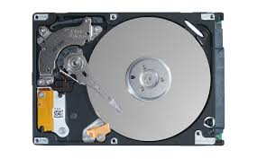
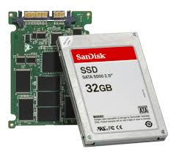
I/O In a Picture
Read / Write
wires
Processor
I/O
Controllers
Secondary Storage (Disk)
Core
L2 Cache
Registers
L1 Cache
interrupts
Secondary Storage (SSD)
Main
Memory
(DRAM)
Read / Write
DMA transfer
L3 Cache (shared)
Core
L2 Cache
Registers
L1 Cache

Slide 3
I/O In a Picture
Read / Write
wires
Processor
I/O
Controllers
Secondary Storage (Disk)
Core
L2 Cache
Registers
L1 Cache
interrupts
Secondary Storage (SSD)
Main
Memory
(DRAM)
I/O Controllers – hardware to support communication between processor and HW
Processor accesses controller’s registers as if memory
Using memory bus or (sometimes) separate bus
Controllers signal processor through interrupts
Read / Write
DMA transfer
L3 Cache (shared)
Core
L2 Cache
Registers
L1 Cache

Slide 4
I/O In a Picture
Read / Write
wires
Processor
I/O
Controllers
Secondary Storage (Disk)
Core
L2 Cache
Registers
L1 Cache
interrupts
Secondary Storage (SSD)
Controllers communicate results through registers or direct memory access to main memory
Main
Memory
(DRAM)
Read / Write
DMA transfer
L3 Cache (shared)
Core
L2 Cache
Registers
L1 Cache

Slide 5
I/O Requirements
Without I/O, computers are useless!
Thousands of devices, each slightly different
Devices unreliable: media failures and transmission errors
Devices unpredictable and/or slow

Slide 6
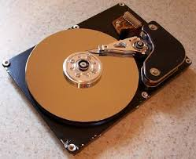
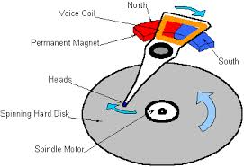
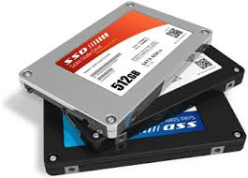

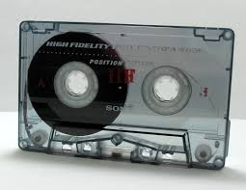
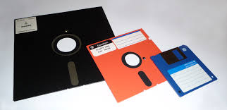
I/O & Storage Layers
Application / Service
High Level I/O
streams
Low Level I/O
handles
Syscall
registers
File System
descriptors
I/O Driver
Commands and Data Transfers
Disks, Flash, Controllers, DMA

Slide 7
Operational Parameters for I/O
Data Granularity: byte (e.g., keyboard) versus block (e.g., disks and network)
Access pattern: sequential (e.g., tape) versus random (e.g., hard drive)
Transfer Notification: Polling vs. Interrupts
Transfer Mechanism: Programmed I/O versus direct memory access

Slide 8

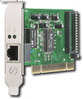
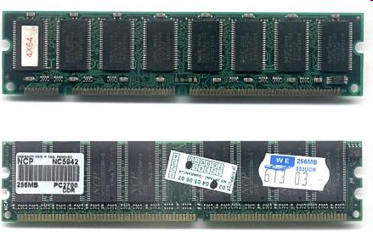
Kernel Device Structure
The System Call Interface
Process
Management
Memory Management
Filesystems
Device Control
Networking
Concurrency, multitasking
Virtual memory
Files and dirs: the VFS
TTYs and device access
Connectivity
Architecture
Dependent
Code
Memory Manager
File System Types
Device Control
Network Subsystem
Block Devices
IF drivers

Slide 9
Kernel Device Structure
The System Call Interface
Process
Management
Memory Management
Filesystems
Device Control
Networking
Concurrency, multitasking
Virtual memory
Files and dirs: the VFS
TTYs and device access
Connectivity
Architecture
Dependent
Code
Memory Manager
File System Types
Device Control
Network Subsystem
Block Devices
IF drivers
Sometimes a lot of (architecture-neutral) layers in front of actual device operations

Slide 10
Kernel Device Structure
The System Call Interface
Process
Management
Memory Management
Filesystems
Device Control
Networking
Concurrency, multitasking
Virtual memory
Files and dirs: the VFS
TTYs and device access
Other times just providing relatively direct access to devices
Connectivity
Architecture
Dependent
Code
Memory Manager
File System Types
Device Control
Network Subsystem
Block Devices
IF drivers

Slide 11
Kernel Device Structure
The System Call Interface
Process
Management
Memory Management
Filesystems
Device Control
Networking
Sometimes primary “users” are parts of the OS – not user programs – but similar interface
Concurrency, multitasking
Virtual memory
Files and dirs: the VFS
TTYs and device access
Connectivity
Architecture
Dependent
Code
Memory Manager
File System Types
Device Control
Network Subsystem
Block Devices
IF drivers

Slide 12
POSIX I/O: Everything is a “File”
Identical interface for:
Devices (terminals, printers, etc.)
Regular files on disk
Networking (sockets)
Local interprocess communication (pipes, sockets)
Based on open(), read(), write(), and close()

Slide 13
Goal of the I/O Subsystem
Provide uniform interfaces (“everything is a file”)
The following code works for many devices:
FILE *fh = fopen("/dev/something", "w"); for (int i = 0; i < 10; i++) { fprintf(fd, "Count %d\n", i); } fclose(fh);
Code that actually controls devices (device drivers) provides a standard interface to kernel I/O subsystem
Kernel handles I/O syscalls by dispatching to proper driver

Slide 14
Options for User I/O Timing
read() and write() block calling thread
Might want other choices:
Handle multiple I/O devices in one thread
Read data as it is available
Queue lots of work at once without using lots of buffering in the kernel

Slide 15
Non-Blocking I/O “Don’t Wait”
read: Just return whatever data is available
write: Just write whatever the kernel can buffer in its memory for now
So read/write calls may not read or write anything
Makes sense for network/terminal/etc.
Questionable for regular files on disk
How much space to allocate for kernel buffers?
What starts a read or write?
On POSIX: fcntl(fd, F_SETFL, flags | O_NONBLOCK)

Slide 16
I/O Multiplexing: select/poll
POSIX way to wait for one of several files to have data available
Supports event-loop style programming
Indicates which file descriptors can read or write data without the need to block
Mix with non-blocking I/O

Slide 17
select() example
int main(void) {
fd_set rfds;
struct timeval tv;
int retval;
FD_ZERO(&rfds);
FD_SET(0, &rfds); // Watch stdin (fd 0) to see when it has input.
FD_SET(my_serial_port, &rfds); // Watch on some other file descriptor.
/* Wait up to five seconds. */
tv.tv_sec = 5; tv.tv_usec = 0;
retval = select(2, &rfds, NULL, NULL, &tv); // this blocks
if (retval == -1)
perror("select()");
else if (retval)
printf("Data is available now.\n");
else
printf("No data within five seconds.\n");
exit(EXIT_SUCCESS);
}

Slide 18
Asynchronous I/O – “Tell Me Later”
Invoke callback function with I/O op completes
User makes a call to start I/O
Specifies buffer in userspace – source of a write or destination for a read
Program can run on CPU while I/O happens (once it is started)
Notification might be signal, system call to poll, …

Slide 19
Basic event loop structure
void callback1 (...) { ... }
void callback2 (...) { ... }
int library () {
event_loop(button_fd, callback1, socket_fd, callback2);
}
int event_loop(int fd1, fn fn1, int fd2, fn fn2) {
struct pollfd poll_list[2];
int retval;
// Setup list of things to wait on.
poll_list[0].fd = fd1;
poll_list[1].fd = fd2;
while(1) {
retval = poll(poll_list, (unsigned long)2 , -1);
if(retval < 0) {
fprintf(stderr,"Error while polling: %s\n",strerror(errno));
return -1;
}
// Handle the event
if((poll_list[0].revents & POLLIN) == POLLIN)
fn1();
if((poll_list[1].revents & POLLIN) == POLLIN)
fn2();
}
}
User psuedocode:
wait_for_button_press(3, function () {
printf(“button press\n”);
});

Slide 20
Streams vs. File Descriptors
Streams are buffered in user memory:
printf("Beginning of line ");
sleep(10); // sleep for 10 seconds
printf("and end of line\n");
Prints out everything at once
Operations on file descriptors are visible immediately
write(STDOUT_FILENO, "Beginning of line ", 18);
sleep(10);
write("and end of line \n", 16);
Outputs "Beginning of line" 10 seconds earlier

Slide 21
Why Buffer in Userspace? Overhead!
Avoid system call overhead
Time to copy registers, transition to kernel mode, jump to system call handler, etc.
Minimum syscall time: ~100s of nanoseconds
Read/write a file byte by byte?
Max throughput of ~10MB/second
With fgetc? Keeps up with your SSD

Slide 22
Why Buffer in Userspace? Functionality.
System call operations less capable
Simplifies operating system
Example: No "read until new line" operation
Solution: Make a big read syscall, find first new line in userspace
Could simulate by one syscall per character, but we already know this is a bad idea

Slide 23


Slide 24
Types of Devices
Block Devices: Hard Drives, Tape Drives, etc.
Access data in blocks (e.g. 4KB)
open(), read(), write(), seek()
Raw I/O or file-system access
Character Devices: Keyboards, mice, serial ports, some USB devices
Read/write one character at a time
Commands include get(), put()
Libraries layered on top to allow line editing

Slide 25
Types of Devices
Network Devices: Ethernet, Wireless, Bluetooth
Distinct enough from block/character devices to have its own interface
Unix and Windows include socket interface
Separates network protocol from network operation
Includes select (multiplexing) functionality
Usage: pipes, FIFOs, streams, queues, …

Slide 26
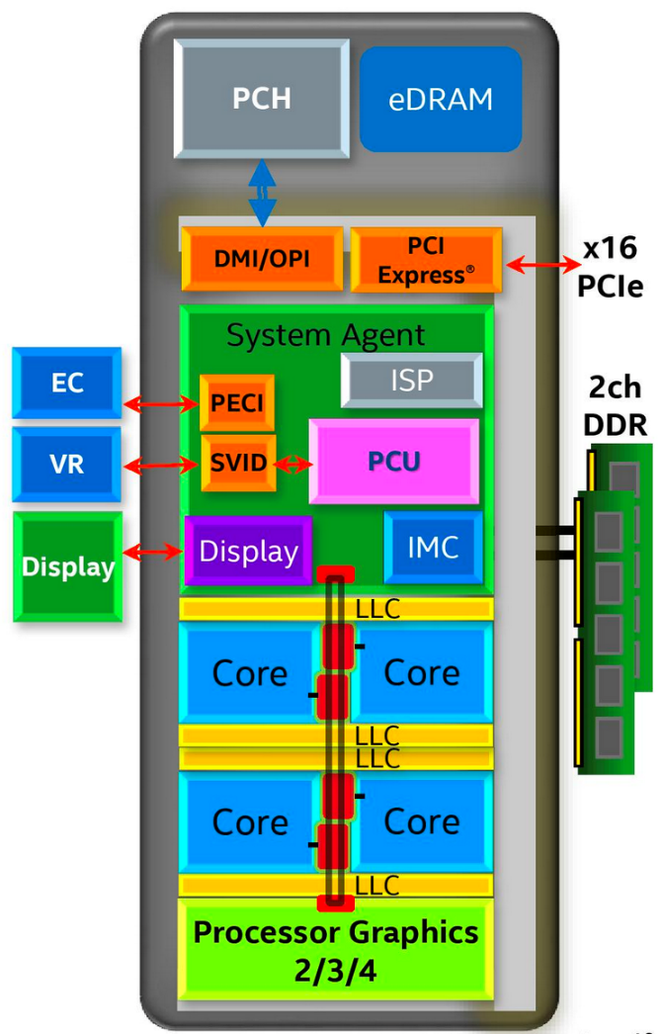
Chip-scale Features of 2015 x86
Significant pieces:
Four CPU cores
Integrated GPU
System Agent (Memory and Fast I/O)
Shared L3 cache
Integrated I/O
Integrated memory controller (IMC)
Two independent channels of DRAM
High-speed PCI-Express (for GPUs)
Direct Media Interface (DMI) Connection to PCH (Platform Control Hub)

Slide 27
Sky Lake I/O: PCH
Platform Controller Hub
Connected to processor with proprietary bus
Direct Media Interface
Types of I/O on PCH:
USB
Ethernet
Audio
BIOS support
More PCI Express
SATA (for Disks)
Sky Lake
System Configuration

Slide 28
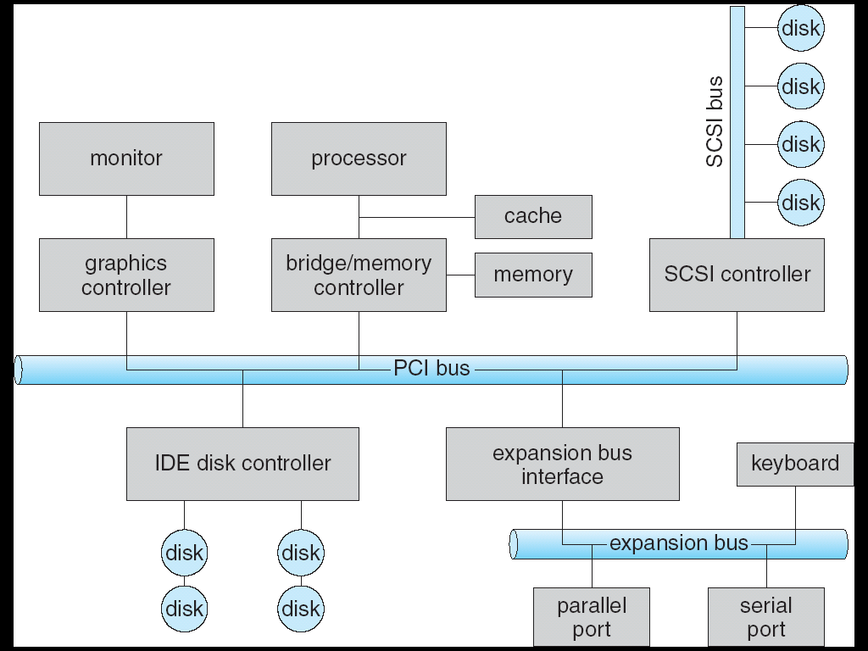
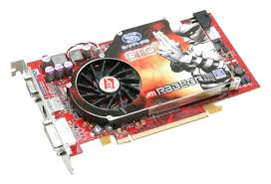
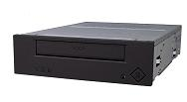
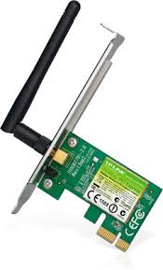
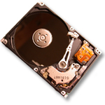
Modern I/O Systems
network

Slide 29
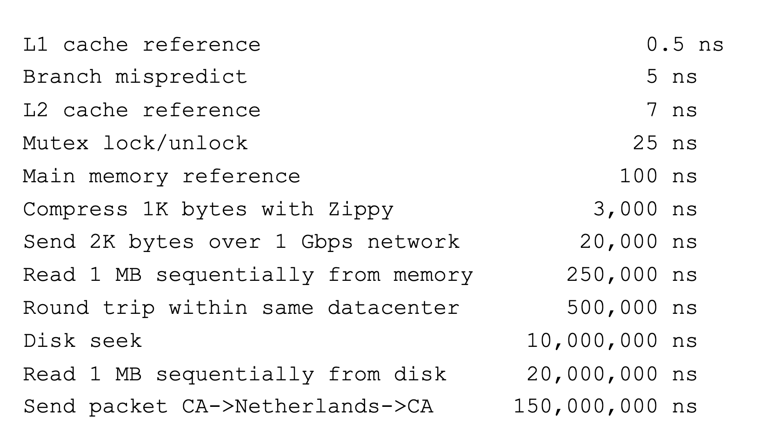
Flashback: Range of Timescales
Jeff Dean: "Numbers Everyone Should Know"

Slide 30
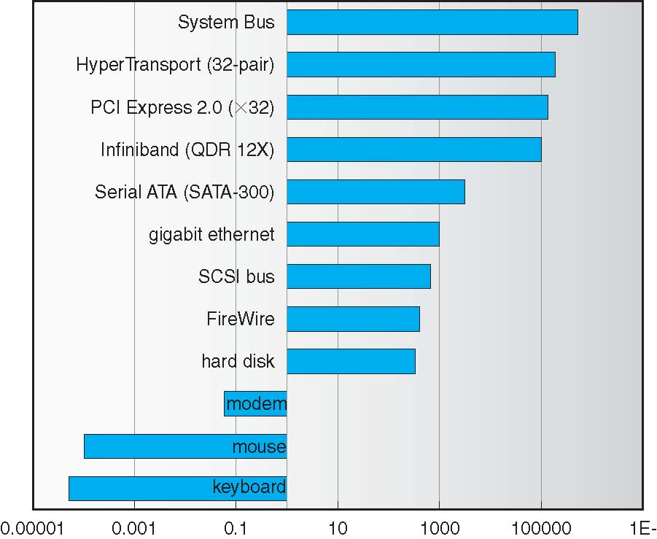
Challenge: Range of Device Data Transfer Rates
Spans over 12 orders of magnitude
OS Goal: Low overhead for fast and slow devices

Slide 31
How does the processor talk to the device?
Processor Memory Bus
Regular
Memory
CPU
Bus
Adaptor
Bus
Adaptor
Device
Controller
Address +
Data
Other Devices
or Buses
Bus
Interface
Hardware
Controller
Interrupt
Controller
Interrupt Request
read
Addressable
Memory
and/or
Queues
write
control
CPU interacts with a Controller
Contains a set of registers that can be read and written
May contain memory for request queues or bit-mapped images
status
Registers
(port 0x20)
Memory Mapped
Region: 0x8f008020

Slide 32
How does the processor talk to the device?
Processor Memory Bus
Regular
Memory
CPU
Bus
Adaptor
Bus
Adaptor
Device
Controller
Address +
Data
Other Devices
or Buses
Bus
Interface
Hardware
Controller
Interrupt
Controller
Interrupt Request
read
Addressable
Memory
and/or
Queues
write
control
Processor accesses controller’s registers in two ways
I/O-specific instructions: in/out
Intel: out 0x21, AL
Memory/mapped I/O: load or store
Registers appear in physical address space
status
Registers
(port 0x20)
Memory Mapped
Region: 0x8f008020

Slide 33
Ex: Memory-Mapped Display Controller
Hardware maps control registers and display memory into physical address space
Addresses set at boot time (on modern OSs)
Simply writing to display memory (“frame buffer”) changes image on screen
Addr: 0x8000F000 — 0x8000FFFF
Writing graphics description to cmd queue
Set of triangles describing some scene
Addr: 0x80010000 — 0x8001FFFF
Writing to the command register may cause on-board graphics hardware to do something
Process current command queue
Addr: 0x0007F004
Can protect with address translation
0x80020000
Graphics
Command
Queue
0x80010000
Display
Memory
0x8000F000
0x0007F004
Command
0x0007F000
Status
Physical
Address
Space

Slide 34
Transferring Data to/from Controller
Programmed I/O: Processor reads/writes data from/to device registers
Pro: Simple hardware (control and data interfaces are the same)
Con: I/O can consume a lot of CPU time
Direct Memory Access (DMA): I/O controller reads/writes from/to RAM without CPU
OS specifies physical address range to use via device controller registers
Pro: CPU can now do other things during large I/O ops

Slide 35
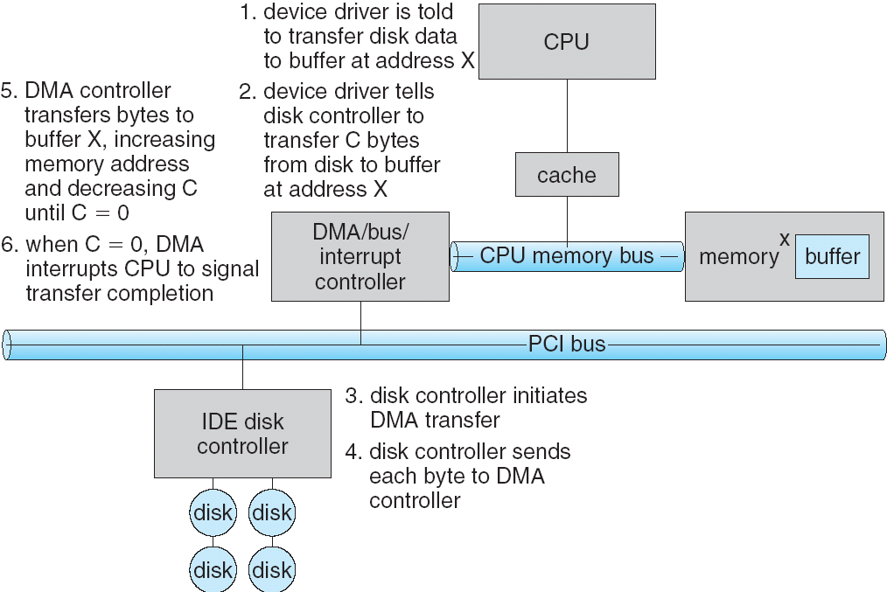
Transferring Data: DMA
1
2
3

Slide 36
Transferring Data: DMA
6
5
4

Slide 37
I/O Devices: Notifying the OS
The OS needs to know when:
The I/O device has completed an operation
The I/O device has encountered an error
Two options:
Interrupts
Polling

Slide 38
I/O Devices: Notifying the OS
Interrupt: Device generates an interrupt whenever it needs CPU’s attention
Pro: Handles unpredictable events well
Con: Handling each interrupt relatively high overhead
Polling: OS periodically checks a device-specific status register
Pro: Low overhead to run this check
Con: May waste cycles checking for infrequent events

Slide 39
I/O Devices: Notifying the OS
Actual devices combine both interrupts and polling
Example: High-bandwidth network adapter
Interrupt for first new incoming packet
OS polls for any subsequent packets until hardware queues are emptied

Slide 40
Basic Performance Concepts
Response Time or Latency: Time to perform an operation(s)
Bandwidth or Throughput: Rate at which operations are performed (op/s)
Files: MB/s, Networks: Mb/s, Arithmetic: GFLOP/s
Startup or Overhead: time to initiate an operation
Most I/O operations are roughly linear in n bytes
Latency(n) = Overhead + n/TransferCapacity

Slide 41
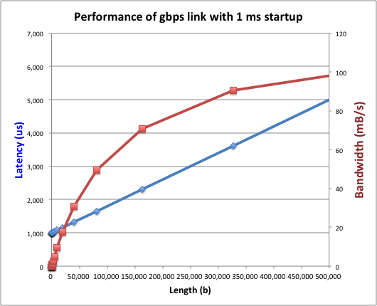
Example: Fast Network
Consider a 1 Gb/s link (B = 125 MB/s)
With a startup cost S = 1 ms

Slide 42
Example: At 10ms startup (More Like a Disk)

Slide 43
What determines peak bandwidth for I/O?
Bus Speed
PCI-X: 1064 MB/s = 133MHz x 64 bit (per lane)
Ultra Wide SCSI = 40 MB/s
USB 3.0 = 5 GB/s
Thunderbolt 3 = 40 Gb/s
Device Transfer Bandwidth
Rotational speed of spinning metal hard drive
Write/Read rate of NAND flash
Signaling rate of network link

Slide 44
Example driver in Linux
CC2520 IEEE 802.15.4 (ZigBee) radio
https://github.com/torvalds/linux/blob/master/drivers/net/ieee802154/cc2520.c

